Slide 1
Stacks
CSE, POSTECH

Slide 2
Stacks
Linear list
One end is called top.
Other end is called bottom.
Additions to and removals from the top end only.

Slide 3
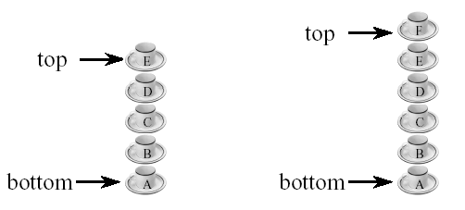
Stack of Cups
Add a cup on the stack.
Remove a cup from the stack.
A stack is a LIFO (Last-In, First-Out) list.
Read Example 8.1

Slide 4
Observations on Stack & Linear List
Stack is a restricted version of linear list
  All the stack operations can be performed as linear list operations
If we designate the left end of the list as the stack bottom and the right as the stack top
  Stack add (push) operation is equivalent to inserting at the right end of a linear list
  Stack delete (pop) operation is equivalent to deleting from the right end of a linear list

Slide 5
Stack ADT
AbstractDataType stack {
instances
linear list of elements; one end is the bottom; the other is the top.
operations
empty() : Return true if stack is empty, return false otherwise;
size() : Return the number of elements in the stack;
top() : Return top element of stack;
pop() : Remove the top element from the stack;
push(x) : Add element x at the top of the stack;
}
See the C++ abstract class stack definition in Program 8.1

Slide 6
Derived Classes and Inheritance
Stack can be defined as a special type of linear list
Class B may inherit members of class A in one of three basic modes: public, protected and private
class B: public A
  protected members of A become protected members of B
  public members of A become public members of B
  cannot access private members of A
class B: public A, private C
  public and protected members of C become private members of B

Slide 7
Array-based Representation of Stack
Since stack is a restricted version of linear list, we can use an array-based representation of linear list (given in Section 5.3.3) to represent stack
Top of stack → element[length-1]
Bottom of stack → element[0]
The class derivedArrayStack defined in Program 8.2 is a derived class of arrayList<T> (Program 5.3)

Slide 8
Derived Array-based class Stack
template<class T> // program 8.2
class derivedArrayStack : private arrayList<T>, public stack<T>
{
public:
derivedArrayStack(int initialCapacity = 10)
: arrayList<T> (initialCapacity) {}
bool empty() const
{return arrayList<T>::empty();}
int size() const
{return arrayList<T>::size();}
T& top()
{
if (arrayList<T>::empty())
throw stackEmpty();
return get(arrayList<T>::size() - 1);
}
void pop()
{
if (arrayList<T>::empty())
throw stackEmpty();
erase(arrayList<T>::size() - 1);
}
void push(const T& theElement)
{insert(arrayList<T>::size(), theElement);}
};

Slide 9
Base Class arrayStack
We learned that a stack class can be defined by extending an arrayList class as in Program 8.2
However, this is not a very efficient implementation
A faster implementation is to develop a base class that uses an array stack to hold the stack elements
Program 8.4 is a faster implementation of an array stack
Read Section 8.3.2

Slide 10
Efficiency of Array-based Representation
Array-based representation of a stack can waste space when multiple stacks are to coexist
An exception is when only two stacks are to coexist
How do we implement two stacks in an array?
  Fix the bottom of one stack at position 0
  Fix the bottom of the other at position MaxSize-1
  The two stacks grow toward the middle of the array
See Figure 8.4

Slide 11
Linked Representation of Stack
Multiple stacks can be represented efficiently using a chain for each stack
Which end of chain should be the stack top?
  If we use the right end of the chain as the stack top, then stack operations push and pop are implemented using chain operations insert(n,x) and erase(n-1) where n is the number of nodes in the chain → Θ(n) time
  If we use the left end of the chain as the stack top, then insert(0,x) and erase(0) → Θ(1) time
What should the answer be?
  Left end!
See Program 8.5 for linked stack definition

Slide 12
Application: Parenthesis Matching
Problem: match the left and right parentheses in a character string
(a*(b+c)+d)
  Left parentheses: position 0 and 3
  Right parentheses: position 7 and 10
  Left at position 0 matches with right at position 10
(a+b))*((c+d)
  (0,4)
  Right parenthesis at 5 has no matching left parenthesis
  (8,12)
  Left parenthesis at 7 has no matching right parenthesis

Slide 13
Parenthesis Matching
(((a+b)*c+d-e)/(f+g)-(h+j)*(k-1))/(m-n)
  Output pairs (u,v) such that the left parenthesis at position u is matched with the right parenthesis at v.
  (2,6) (1,13) (15,19) (21,25) (27,31) (0,32) (34,38)
How do we implement this using a stack?
  Scan expression from left to right
  When a left parenthesis is encountered, add its position to the stack
  When a right parenthesis is encountered, remove matching position from the stack

Slide 14
Example of Parenthesis Matching
  (((a+b)*c+d-e)/(f+g)-(h+j)*(k-1))/(m-n)
…
stack
2
1
1
15
21
0
0
0
0
0
0
0
…
output
(2,6)
(1,13)
(15,19)
(21,25)
See Program 8.6
Do the same for (a-b)*(c+d/(e-f))/(g+h)

Slide 15
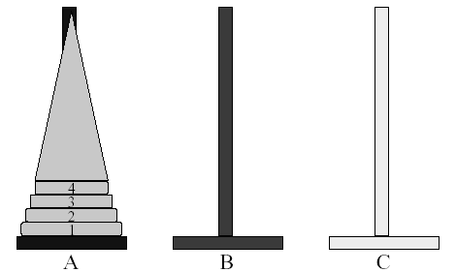
Application: Towers of Hanoi
Read the ancient Tower of Brahma ritual (p. 285)
n disks to be moved from tower A to tower C with the following restrictions:
  Move 1 disk at a time
  Cannot place larger disk on top of a smaller one

Slide 16
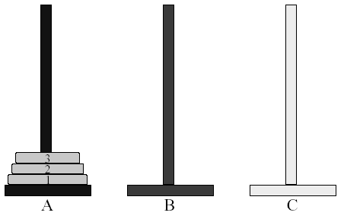
Let’s solve the problem for 3 disks

Slide 17
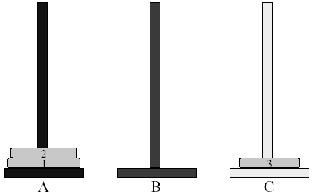
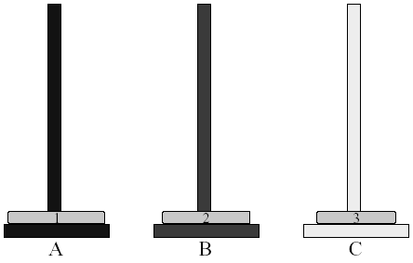
Towers of Hanoi (1, 2)

Slide 18
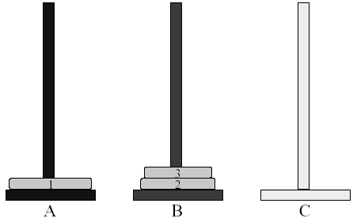
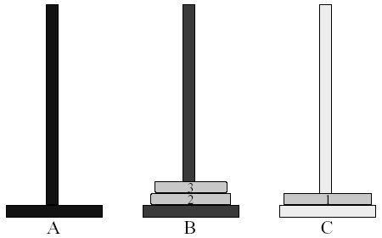
Towers of Hanoi (3, 4)

Slide 19
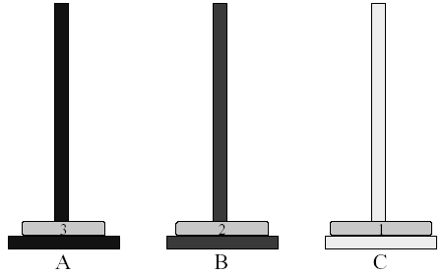
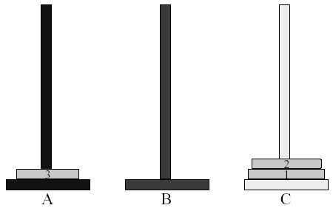
Towers of Hanoi (5, 6)

Slide 20
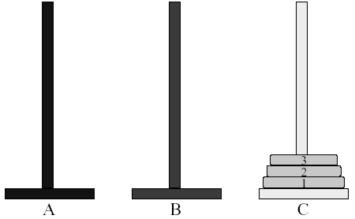
Towers of Hanoi (7)
So, how many moves are needed for solving 3-disk Towers of Hanoi problem?
➔ 7

Slide 21
Time complexity for Towers of Hanoi
A very elegant solution is to use recursion. See Program 8.7 for Towers of Hanoi recursive function
The minimum number of moves required is 2^{n}-1
Time complexity for Towers of Hanoi is
Θ(2^{n}), which is exponential!
Since disks are removed from each tower in a LIFO manner, each tower can be represented as a stack
See Program 8.8 for Towers of Hanoi using stacks

Slide 22
Recursive Solution
n > 0 gold disks to be moved from A to C using B
move top n-1 disks from A to B using C
1
A
B
C

Slide 23
Recursive Solution
move top disk from A to C
1
A
B
C

Slide 24
Recursive Solution
move top n-1 disks from B to C using A
1
A
B
C

Slide 25
Recursive Solution
moves(n) = 0 when n = 0
moves(n) = 2*moves(n-1) + 1 = 2^{n}-1 when n > 0
1
A
B
C

Slide 26
64-disk Towers of Hanoi Problem
How many moves is required to move 64 disks?
➔ moves(64) = 2⁶⁴-1 = 1.8 * 10¹⁹ (approximately)
How long would it take to move 64 gold disks by the Brahma priests?
➔ At 1 disk move/min, the priests will take about 3.4 * 10¹³ years.
➔ “According to legend, the world will come to an end when the priests have competed their task”
How long would it take to move 64 disks by Pentium 5?
➔ Performing 10⁹ moves/second, a Pentium 5 would take about 570 years to complete.
- try running hanoiRecursive.cpp on your computer using n=3, 4, 10, 20, 30 and find out how long it takes to run

Slide 27
Application: Rearranging Railroad Cars
Read the problem on p. 289
Rearrange the cars at a shunting yard that has an input track, and output track, and k holding tracks between the input and output tracks
See Figure 8.6 for a three-track example
See Figure 8.7 for track states
See Program 8.9, 8.10 and 8.11

Slide 28
READING
Read 8.5.4 Switch Box Routing Problem
Read 8.5.5 Offline Equivalence Problem
Read 8.5.6 Rat in a Maze
Read all of Chapter 8

